Slide 1
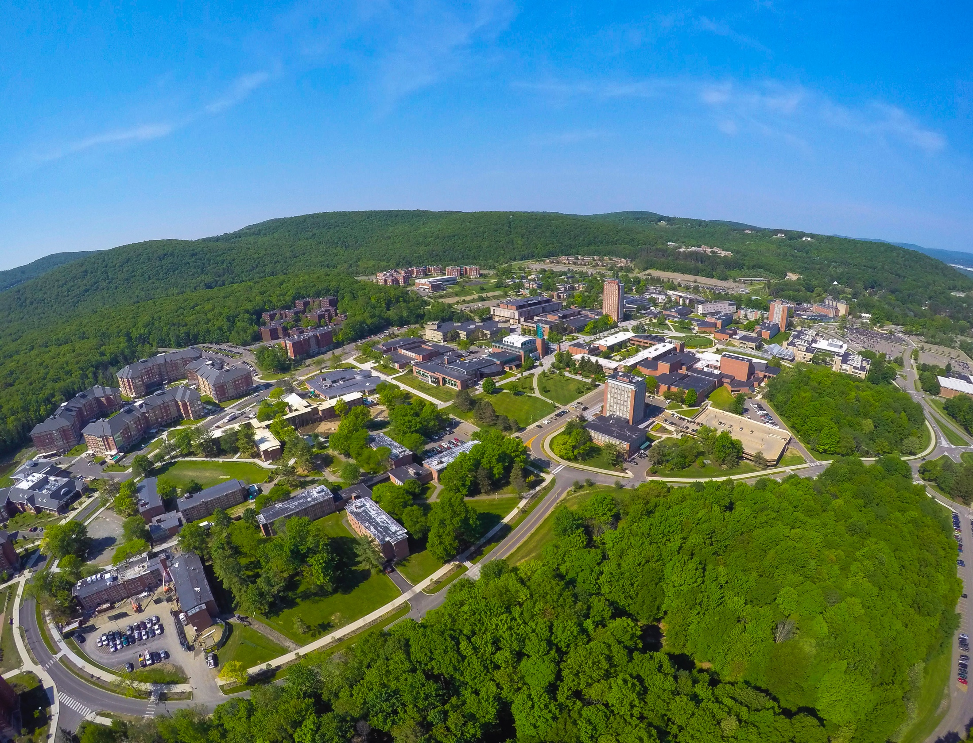

“Traffic Flow Simulation Using the Burgers Equation”
By: Malak Fora, Rahul Gupta, Ye Chen, Saif AL-Nimer
Prof. Hiroki Sayama

Slide 2
Agenda
Introduction
Methodology
Results Analysis
Conclusion
Future Work

Slide 3
Problem and Objective
Problem
Traffic congestion is a major problem in urban areas and has significant social, economic, and environmental impacts
Objective
Considering fluid dynamics simulation
Utilizing Burgers equation
Traffic flow modeling and simulation
Analyzing different scenarios for traffic flow management

Slide 4
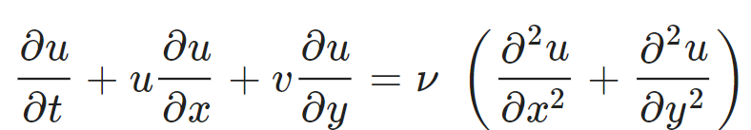
Methodology
Burger's equation
Non-linear partial differential equation (PDE)
A simplified form of the Navier-Stokes equation that describes the motion of a fluid
Convection term
Diffusion term

Slide 5
Methodology
Traffic Flow
Movement of vehicles on a road network, characterized by speed, density, and flow rate
Types of traffic flow
Free flow (no delays or obstructions)
Congestion (density exceeds the threshold, reducing speed and flow rate)
Shockwaves (sudden change in traffic conditions causing a wave of congestion)

Slide 6

Model Design
Conceptual Model
Rectangle shape spots
Randomly selected locations
Varying density values
$$ρ_{Bacground=0.2} ρ_{Spot=[0,1]}$$

Slide 7

Model Design
Road dimensions: length (Lx) = 2 units, width (Ly) = 6 units
Multiple spots of varying densities represent different traffic conditions
Maximum allowed density and velocity = 1
Density-velocity relationship:
$$v=v_{max}\left(1−\frac{ρ}{ρ_{max}}\right)$$

Slide 8
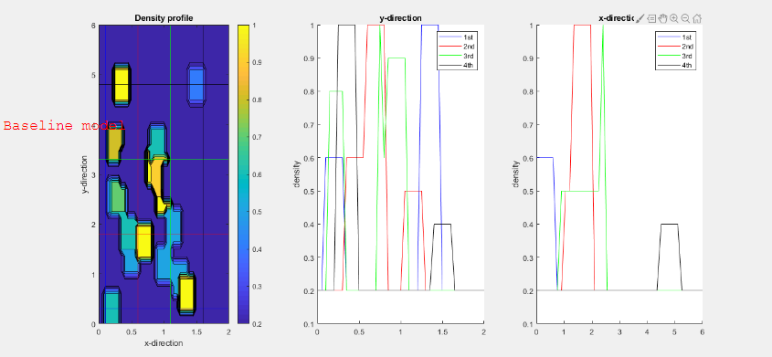
Results Analysis
Notes:
This is our baseline model, as you can see from the velocity and density graph on the LHS, initially there is no traffic jam in our road and the colors represents for the density. Blue represents a relatively low density and yellow represents a relatively high density. The curves on the RHS are the representation for the level of density based on different locations from the view of y-direction and x- direction.

Slide 9
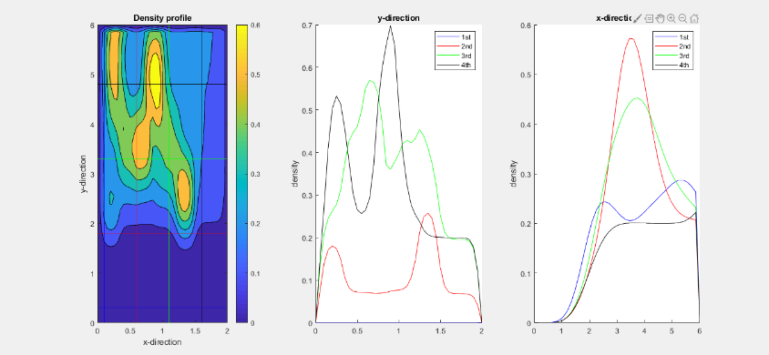
Results Analysis
Notes:
From the contour graph, there are 2 spots of traffic fluids which have already met, and there is another spot which haven't met them at this point.

Slide 10
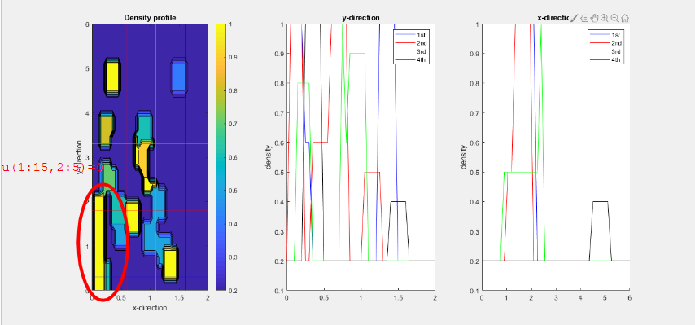
Results Analysis
Notes:
In this case, we put a traffic jam in the lower left corner of the figure. What we want is to do a comparison between this case and the baseline model we mentioned before and see what will happen.

Slide 11
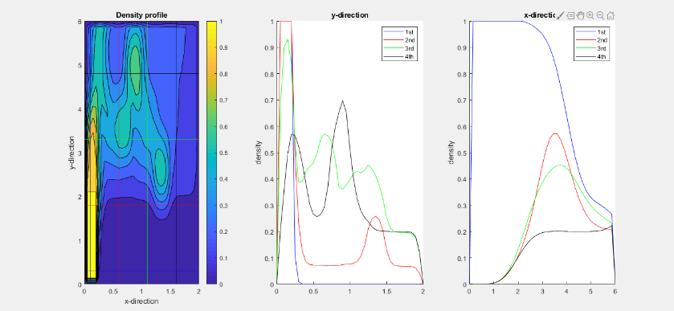
Results Analysis
Notes:
After running the model, we got this contour graph and it is clear that there is a serious traffic jam on the lower left corner, where the traffic fluid is getting longer and longer. In this case, some actions should be taken by the department of traffic management.

Slide 12
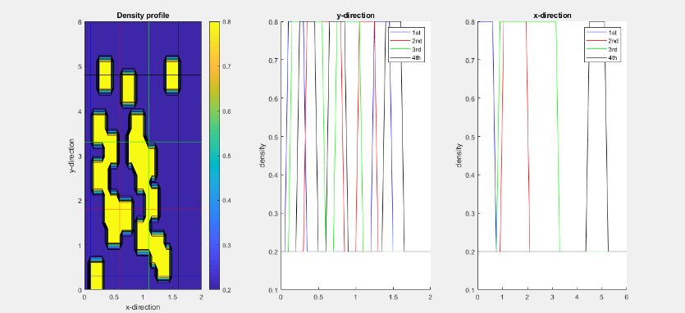
Results Analysis
Notes:
This is another scenario, in this case, we initially set the density and the velocity for each spot are the same.

Slide 13
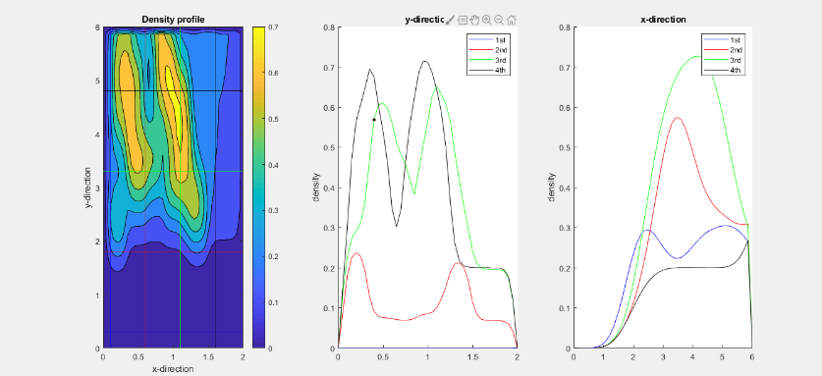
Results Analysis
Notes:
After running the model for a specific long run, as you can see from the contour graph, it seems like that there are 4 spots already met at this point. Through this way, we can do the prediction for the status of the traffic flow in our road and send the alarm to the drivers who are driving in the back and remind them to change their route and go to other roads, which will be useful for releasing the pressure of our traffic management.

Slide 14
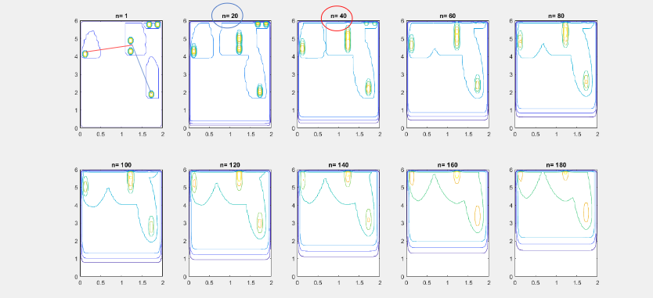
Results Analysis

Slide 15
Conclusion and Future Work
Model typically consists of three main components
Traffic demand
Traffic supply
Traffic control
Future work
Work on more complex scenarios
Car moves diagonally
The impact of the entry of new cars
Traffic flow optimization
The impact of autonomous vehicles on traffic flow

Slide 16


